Slide 1

Predicting Hospital Readmissions
Data606 phase 3
Team C:
Brett Duvall
Mohammedamin Mussa
Luis Vargas Ramirez

Slide 2
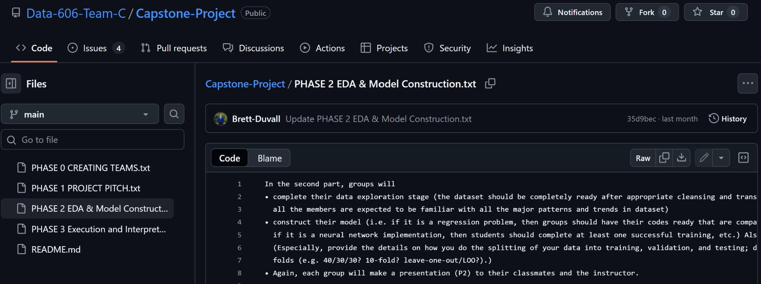
Size: 101,766 encounters, 50 variables, 18 MB.
Categories: demographics, diagnoses, labs (A1C, glucose), medication use, utilization.
Target: 30 day readmission.
https://github.com/Data-606-Team-C

Slide 3
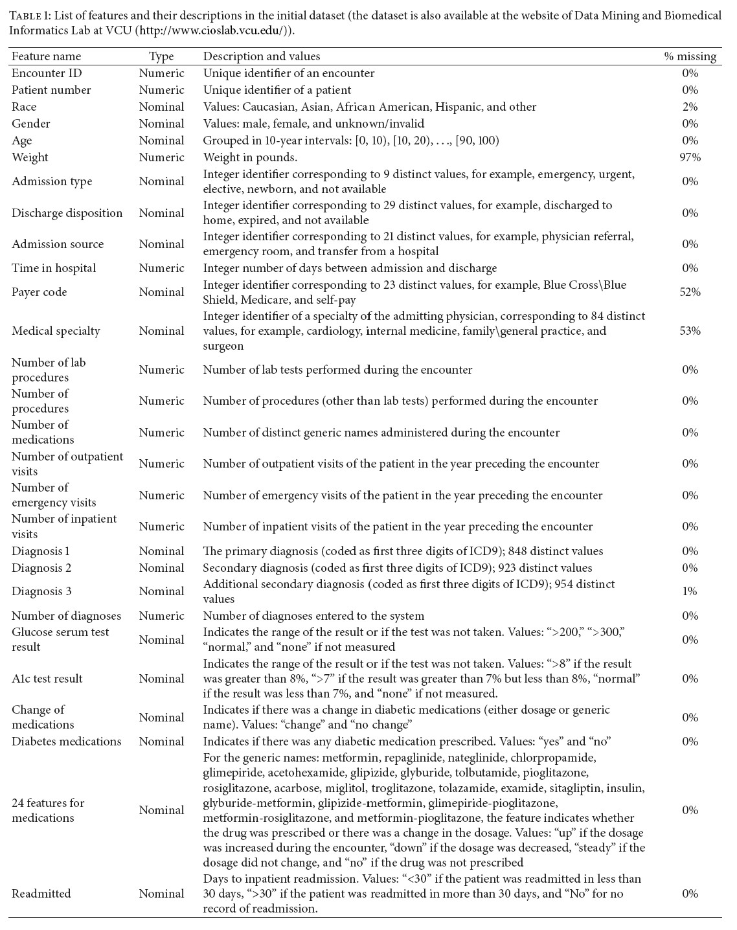
Machine Learning – Classification
Target ('readmitted') has 3 categories:
<30 (the focus of our classification)
>30
NO
Features kept even though missing values:
A1C test result
Glucose serum test result
Unnecessary features (administrative or missing values):
weight
admission type
admission source
payer code
medical specialty (of admitting physician)
Dataset:
https://drive.google.com/file/d/1fMbjB-5I0Suifh4QrpH1ewtXxvkAtayd/view?usp=sharing

Slide 4
Literature Review
Strack et al. (2014) analyzed 70,000 clinical records in the UCI Diabetes Readmission dataset and found that conducting HbA1c testing during hospitalization was strongly associated with reduced 30-day readmission rates. Their study introduced the dataset that serves as the foundation for many subsequent projects, including ours.
Wang and Zhu (2021) reviewed challenges and solutions in predictive modeling of hospital readmissions using machine learning. They compared several algorithms, including Random Forest, Support Vector Machines, and Logistic Regression, reporting AUC values typically between 0.62 and 0.70. Their work emphasizes issues such as class imbalance and preprocessing, which our project addresses using class weighting and consistent encoding.
Ashfaq et al. (2019) implemented deep learning models such as convolutional and recurrent neural networks for hospital readmission prediction using electronic health records. Their study demonstrated improved recall and AUC over traditional models, motivating our comparison between ensemble and neural approaches for clinical prediction tasks.
Emi-Johnson (2025) showed the potential of ML algorithms, particularly XGBoost, in enhancing the prediction of 30-day hospital readmissions using structured EHR. By comparing four different models, they demonstrated that ensemble-based methods such as XGBoost not only provide superior predictive performance but also robust interpretability via SHAP analysis.
Shukla and Tripathi (2020) proposed an embedding-based model (EmbPred30) for predicting 30-day readmissions for diabetic patients using the same UCI dataset. Their results showed that categorical embeddings and gradient boosting improved model accuracy compared with traditional one-hot encoding. This supports our focus on feature engineering to enhance model performance.

Slide 5

Literature Review Metrics
Ashfaq et al. (2019)
AUC 0.73
Emi-Johnson (2025)
AUC 0.58 - 0.67
Shukla and Tripathi (2020)
AUC 0.71
Strack et al. (2014)
AUC 0.61 – 0.63
Wang and Zhu (2021)
AUC 0.62 – 0.70

Slide 6
Additional Literature Review
Combining Patient Visits – Burrill (2025)
Adding created features
A1C Test Reasoning -Strack et al. (2014)
3 main admittance values
Diabetes
Circulatory
Respiratory

Slide 7

Data Exploration

Slide 8
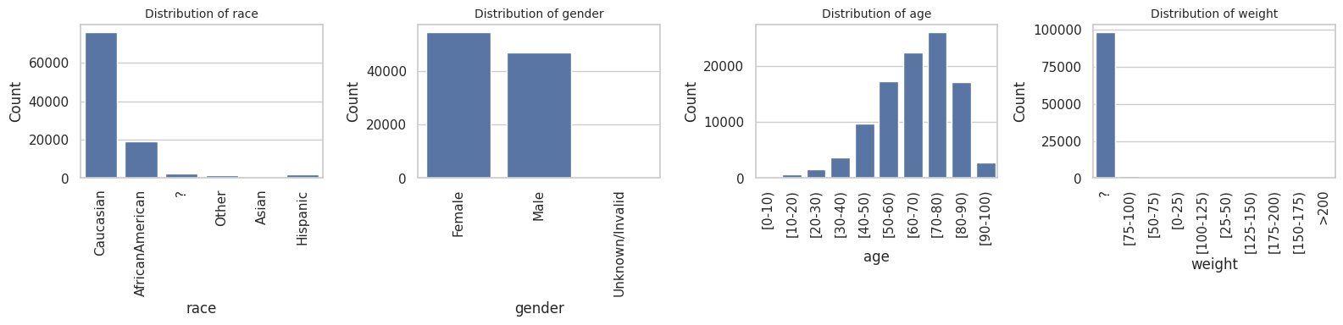
Data Distribution

Slide 9
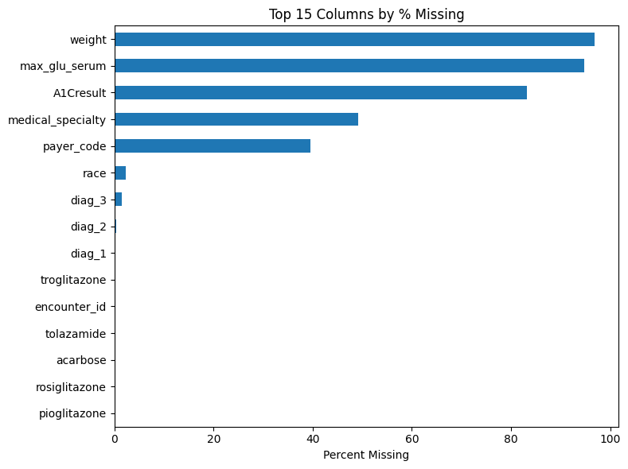
Missing values
Serum glucose is a test that measures the amount of glucose (sugar) in a patient's blood.
A1C test measures the average amount of sugar in your blood over the past few months
 | Missing Values | Percentage
max_glu_serum | 96420 | 94.746772
A1Cresult | 84748 | 83.277322

Slide 10
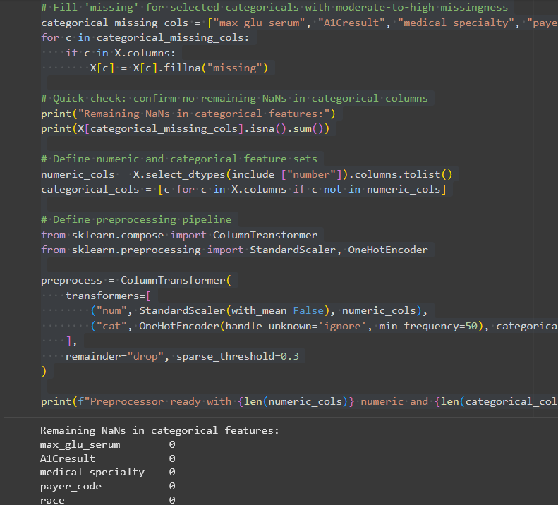
Dealing with missing values
Why keeping two of the highest features with missing values?

Slide 11
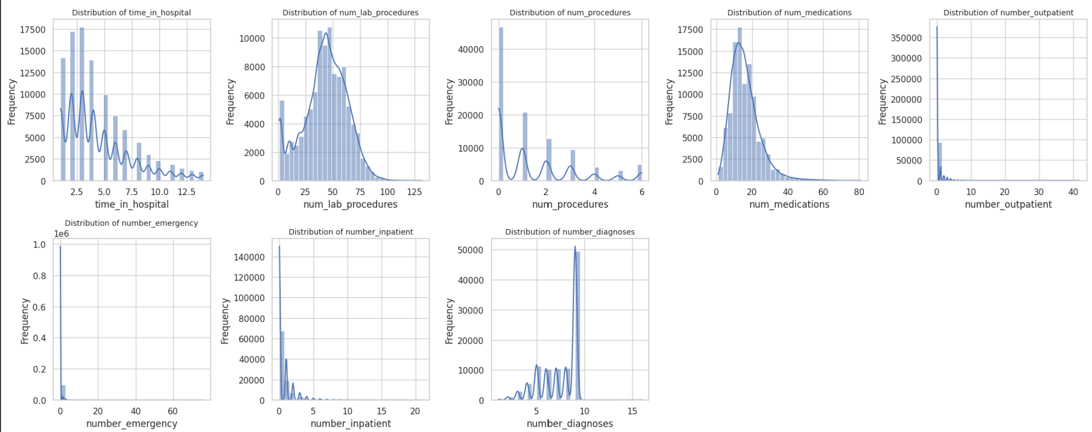
Distribution of Numeric Features

Slide 12
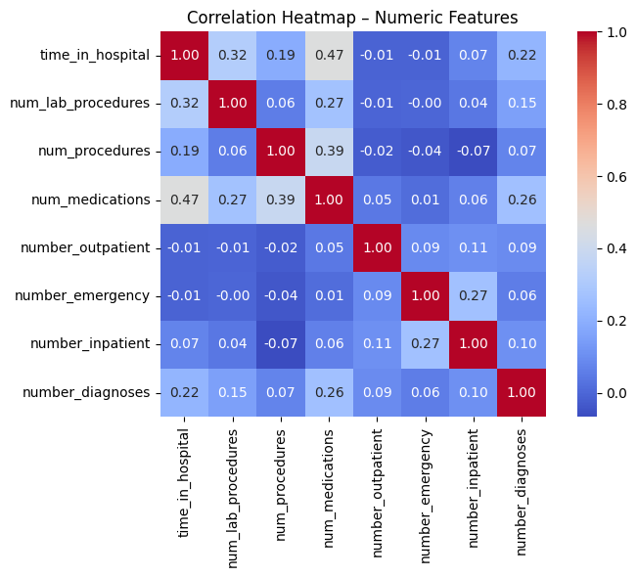
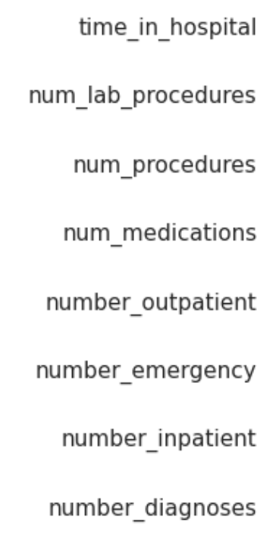
Correlation Among Numeric Features
Moderate positive correlations between longer hospital stays and more medications, also medications and procedures(other than lab tests).
Most variables have weak relationships.

Slide 13
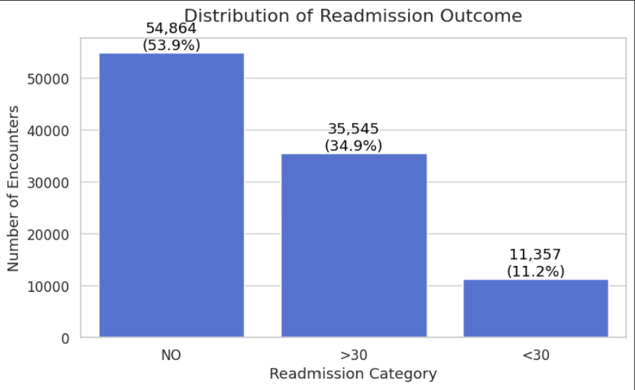
Distribution of Target Features
After defining our binary target variable, we identified a significant class imbalance. This imbalance becomes and important consideration when we move into the modeling phase.

Slide 14
Model Construction

Slide 15
Model Construction and Validation
Goal: Predict 30-day hospital readmission among diabetic patients using the UCI Diabetes Readmission dataset (101,766 records, 8 numeric, 38 categorical features).
Task Type: Binary classification
Target variable: readmitted <30 days (1) vs ≥30 days or no readmission (0)
Imbalance: ~11% positive (readmitted within 30 days)
1. Cohort & Target Definition
Target: Binary Class (<30 Days vs. All Others).
Exclusions: Death / Hospice (ineligible for readmission).
Imbalance Handling: ~11% Positive Class; addressed via scale_pos_weight to penalize false negatives.
2. Leakage Prevention (Crucial Step)
Risk: "Time-Travel" (training on a patient's future visit to predict their past).
Solution: GroupShuffleSplit on patient_nbr.
Outcome: Enforced strict separation—no patient ID overlaps between Train and Test sets.
3. Feature Engineering
New Feature: visit_count (Aggregated historical inpatient/outpatient visits).
Result: Proved to be a stronger predictor of "instability" than static lab results (e.g., A1C).
Evaluation Metrics:
ROC-AUC (overall ranking ability)
PR-AUC (performance on rare positives)
Precision@Top-20 % (clinical targeting usefulness)
F1 score (balance of precision and recall)

Slide 16
Model Portfolio
Model Comparison
Logistic Regression – interpretable linear baseline.
Random Forest – ensemble of decision trees capturing non-linear patterns.
Gradient Boosting – sequential tree model emphasizing hard cases.
XGBoost – optimized gradient boosting; best for structured data.
Design Choices:
Missing values handled; categorical variables encoded; numeric features scaled.
Class imbalance addressed with class_weight=‘balanced’.
Consistent preprocessing pipeline applied to all models.

Slide 17
Model Performance (Base vs Cross-Validation)
Model Selection: Tested linear vs. non-linear approaches using 3-Fold Stratified Group Cross-Validation.
Model | CV AUC (Mean) | Precision (Top 20%) | Key Observation
Logistic Regression (Baseline) | 0.660 | 19.5% | Established linear "ceiling"; limited by feature complexity.
Random Forest | 0.662 | 20.1% | Struggled to significantly outperform the baseline.
XGBoost (Champion) | 0.675 | 21.4% | Best Performance. Handled missing values natively & captured non-linear interactions.

Slide 18
Choosing the Right Metric for Hospital Readmission
Why XGBoost Won:
Robustness: Natively handled missing A1Cresult values (informative missingness).
Optimization: Tuned via Grid Search (max_depth=3, learning_rate=0.2) to prevent overfitting on noisy clinical data.
The Champion Model (Results & Interpretation)
Performance Ceiling:
The model stabilizes at AUC ~0.675. Adding explicit comorbidity flags (Diabetes, CHF) yielded no gain, confirming the model effectively learned these patterns from raw diagnosis codes.
Feature Importance (Top Drivers):
number_inpatient: Prior inpatient stays are the #1 predictor of risk.
visit_count: Total history reflects chronic instability.
discharge_disposition: Where the patient went (e.g., home vs. SNF) highly correlates with return risk.
Confusion Matrix Strategy:
Prioritized Recall over Precision.
Trade-off: We accept higher False Positives to ensure we do not miss high-risk patients (False Negatives).
Metric | Value | What it means (The Answer)
ROC-AUC | 0.675 | "This is our global ranking score. 0.5 is random, 1.0 is perfect. 0.675 shows we have a solid signal that outperforms the 0.64 baseline."
PR-AUC | 0.112 | "This reflects the difficulty of the imbalance. Since only 11% of patients are readmitted, the baseline is low. This metric is sensitive to the difficulty of the task."
Precision @ Top 20% | ~21.4% | (Most Important) "This is our efficiency. If we intervene on the top 20% of risk, ~1 in 5 patients we call will be a true readmission. This is 2x better than random calling (11%)."
Recall @ Top 20% | ~38.2% | "This is our 'Capture Rate'. By targeting just 20% of patients, we catch nearly 40% of all future readmissions."

Slide 19
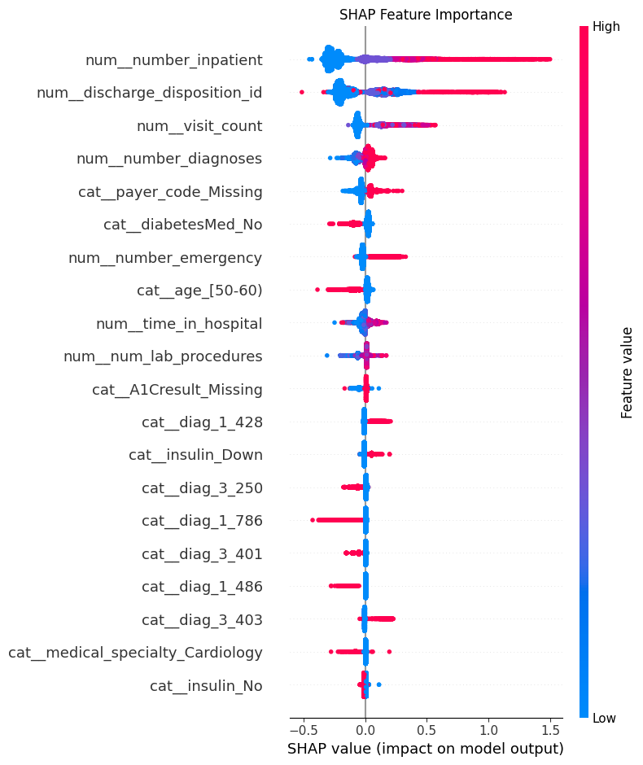
What Drives Readmission Risk?
Top Predictors:
visit_count (Dominant): A patient's history of instability is the strongest predictor—often outweighing current lab results.
Discharge Disposition: Where a patient goes next (e.g., home vs. SNF) is a critical risk multiplier.
Medication Load: Higher num_medications correlates with complexity and fragility.
Clinical Insight:
The model learns that chronic instability (frequent returns) is more dangerous than specific acute diagnoses.
Actionable Takeaway: Interventions must target the pattern of usage, not just the acute symptom.

Slide 20
Business Impact & Deployment
Policy Recommendation: The "Top 20%" Threshold
Instead of intervening on everyone, we target the top risk tier.
Impact: Focusing resources on the top 20% doubles the efficiency of case managers compared to random assignment.
Strategy | Population Targeted | Readmissions Captured | Precision
Random Intervention | 100% | 100% | 11% (Baseline)
Model-Guided Policy | Top 20% | ~38.2% | ~21.4%

Slide 21
Benchmarking Against Prior Studies
How Our Results Compare
Strack et al., 2014 (UCI baseline) – AUC 0.61 – 0.63 → our XGBoost 0.675 = major improvement over the original logistic model.
Wang & Zhu, 2021 – AUC 0.62 – 0.70 → our ensemble 0.68 – 0.675 = comparable to modern ML benchmarks.
Shukla & Tripathi, 2020 – AUC 0.71 (embedding model) → our XGBoost 0.675 = slightly lower but close.
Ashfaq et al., 2019 (deep learning) – AUC 0.73 → our XGBoost 0.675 = near deep-learning performance with simpler, interpretable methods.
Interpretation
Our ensemble models (XGBoost, Gradient Boosting) perform on par with or better than most published traditional ML approaches.
They achieve strong, stable AUC and PR-AUC scores while remaining easier to interpret and deploy.
Key Takeaways
Best Model: XGBoost (ROC-AUC ≈ 0.675, PR-AUC ≈ 0.21.4)
Clinical Targeting: Gradient Boosting slightly higher precision @ 10 %.
Consistency: Results align with the 0.62–0.73 AUC range reported across the literature.

Slide 22
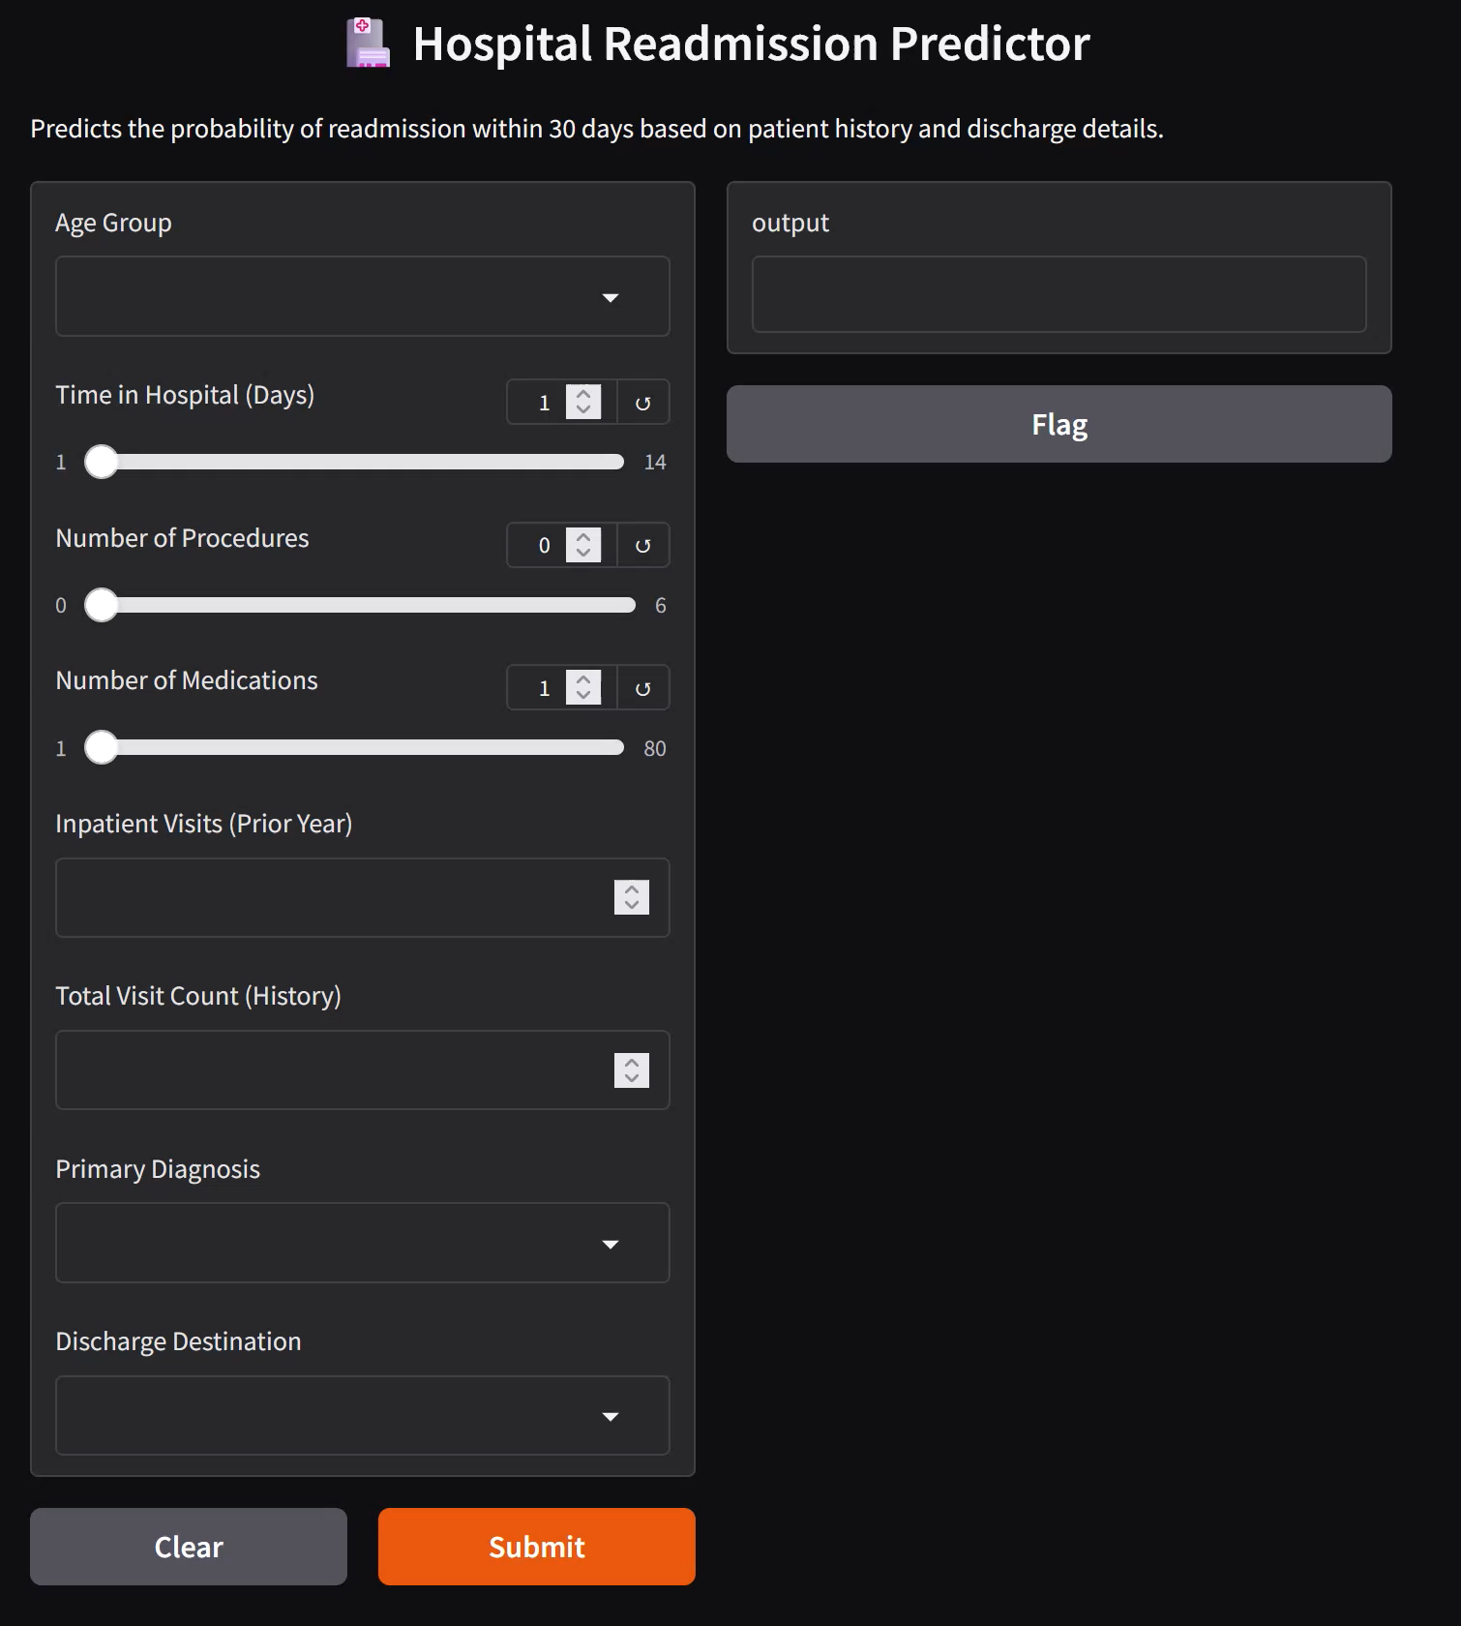
Gradio Demonstration
Model will classify whether patient is at risk for <30 days readmittance
Client can input top features
This is for clean demo purposes
Final product can allow for all features
Client can choose to adjust patient's treatment

Slide 23

Thank You. Any Questions?
REFERENCES
Ashfaq, A., Sant’Anna, A., Lingman, M., & Nowaczyk, S. (2019). Readmission prediction using deep learning on electronic health records. Journal of Biomedical Informatics, 97, 103271. https://doi.org/10.1016/j.jbi.2019.103271
Emi-Johnson O., Nkrumah K. "Predicting 30-Day Hospital Readmission in Patients With Diabetes Using Machine Learning on Electronic Health Record Data." (April 17, 2025), Cureus 17(4): e82437. DOI 10.7759/cureus.82437
Shukla, S., & Tripathi, S. P. (2020). EmbPred30: Assessing 30-days readmission for diabetic patients using categorical embeddings. arXiv preprint, arXiv:2002.11215. https://arxiv.org/abs/2002.11215
Strack, B., DeShazo, J. P., Gennings, C., Olmo, J. L., Ventura, S., Cios, K. J., & Clore, J. N. (2014). Impact of HbA1c measurement on hospital readmission rates: Analysis of 70,000 clinical database patient records. BioMed Research International, 2014, 781670. https://doi.org/10.1155/2014/781670
Wang, S., & Zhu, X. (2021). Predictive modeling of hospital readmission: Challenges and solutions. arXiv preprint, arXiv:2106.08488. https://arxiv.org/abs/2106.08488
Burrill, L. UC Berkeley (2025). diabetes_readmission [Computer software]. https://github.com/lelandburrill/diabetes_readmission

